Slide 1
Arbitrary Waveform Generator Python Programming and Peltier Module Test Environment
Richard McManus
University of Notre Dame, Electrical Engineering

Slide 2
PROJECT 1: Arbitrary Waveform Generator Python Programming
Goal: Develop a process to load in and generate waveforms from a table (e.g., .xlsx or .csv file)
Needed to be simple to use
Capable of adjustments in a timely manner

Slide 3

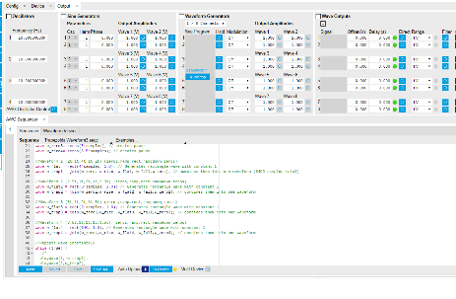
Background
Previously generated waveforms using the LabOne GUI
Hardcoded values
Cut and joined ramp and rectangular waves

Slide 4
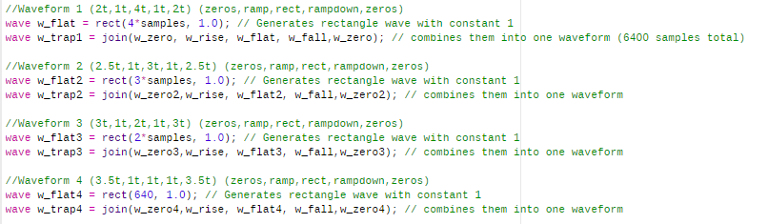
Background

Slide 5
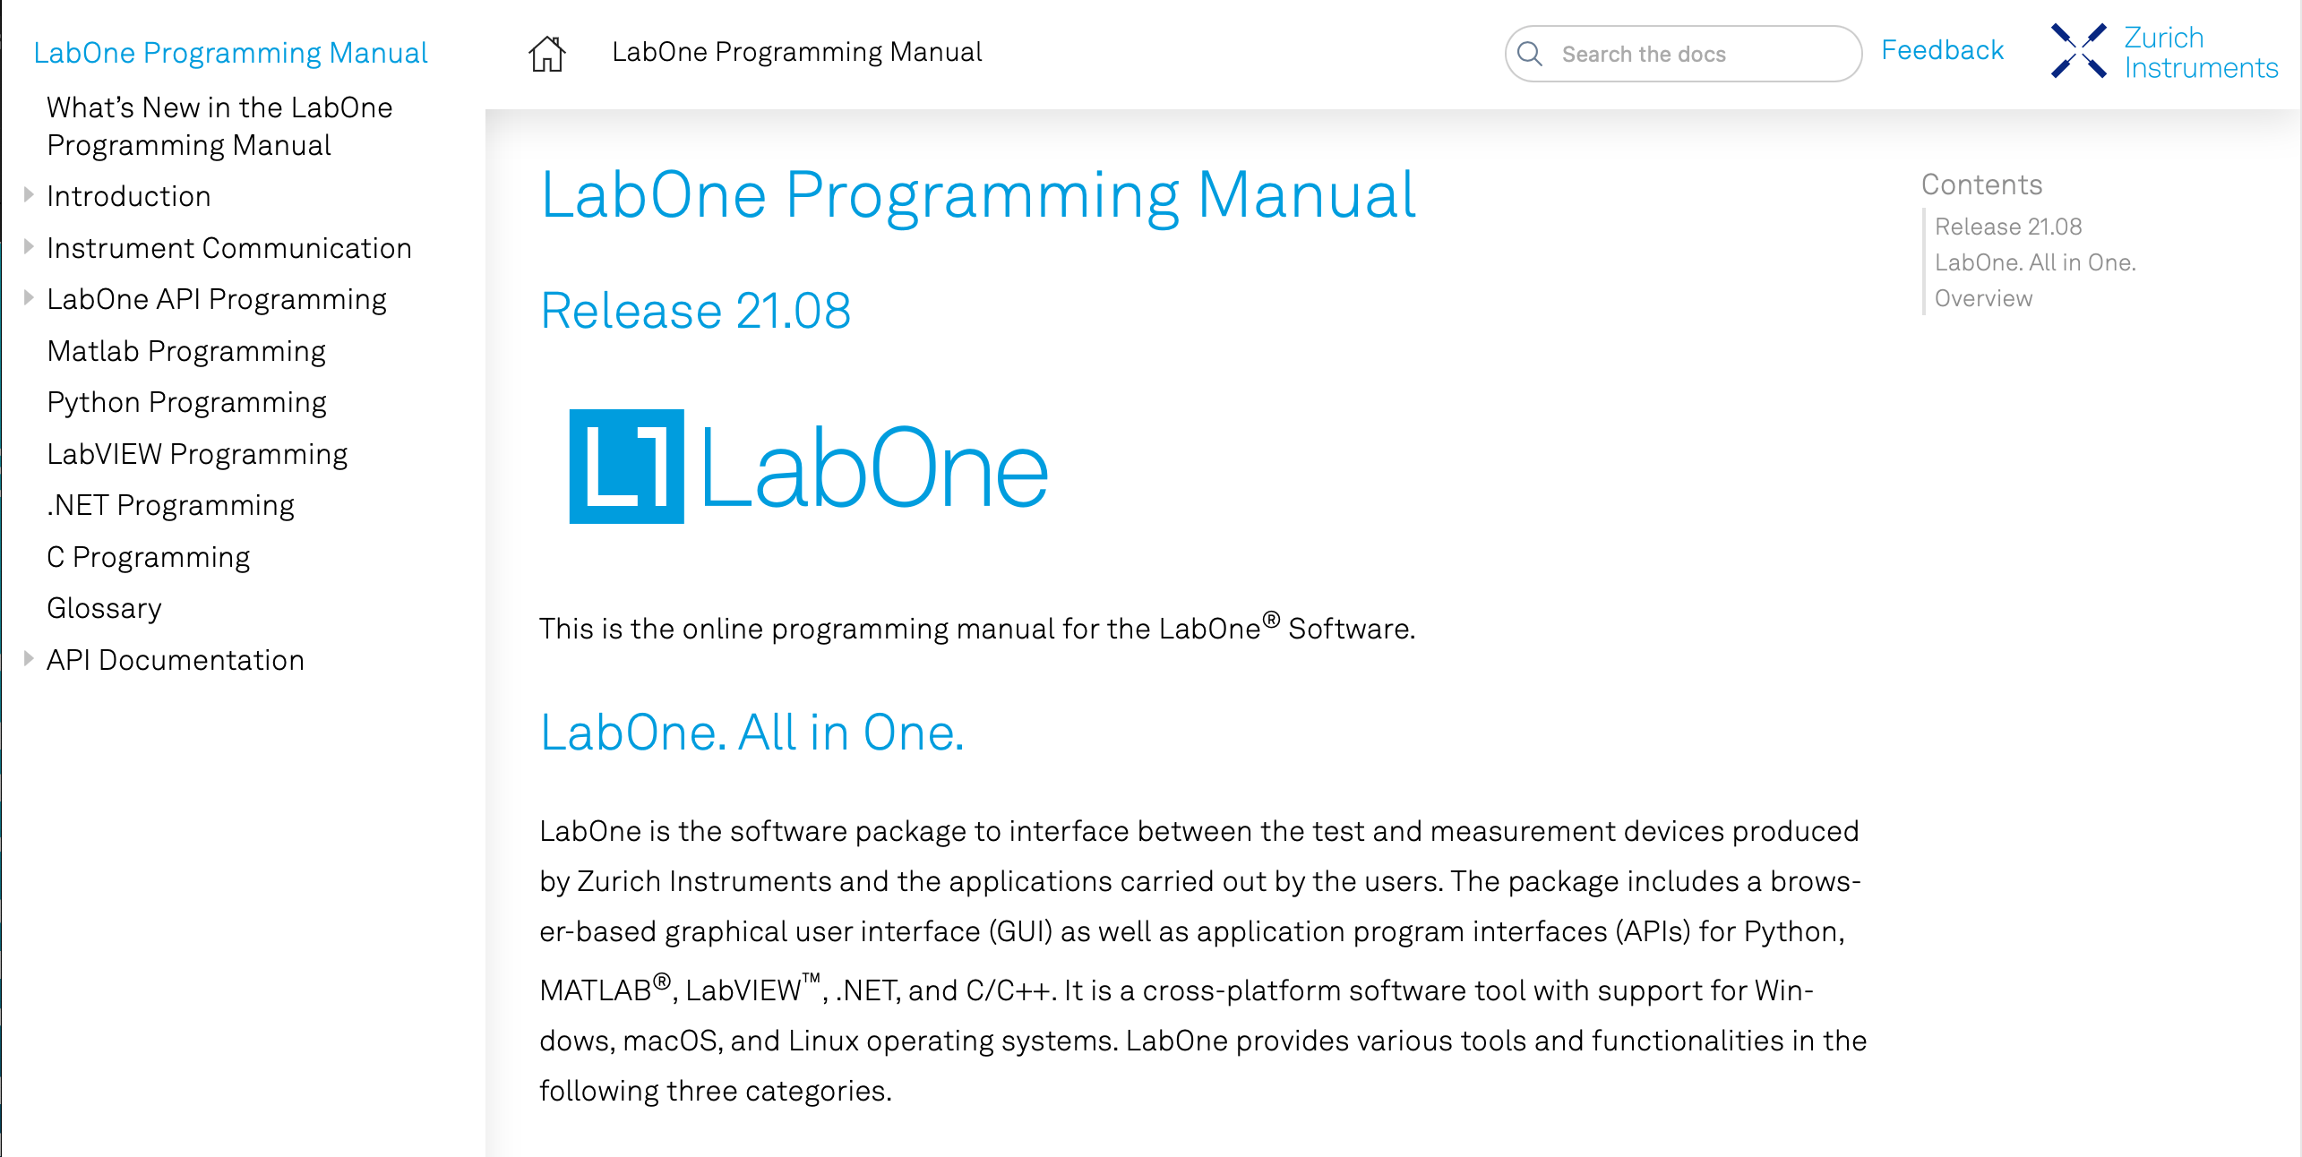
Learning labone and programming apis
Referenced both
HDAWG Manual:
https://docs.zhinst.com/pdf/ziHDAWG_UserManual.pdf
LabOne Programming Manual:
https://docs.zhinst.com/labone_programming_manual/overview.html
Worked through tutorials and example code

Slide 6
Implementing APIs
Initial attempt was made in Matlab
Errors in MATLAB when attempting to run example code
Emailed Jorge Medina for assistance
Suggested using python and updating to the latest versions of both the LabOne Web Server and LabOne Data Server
Began working with Python API

Slide 7
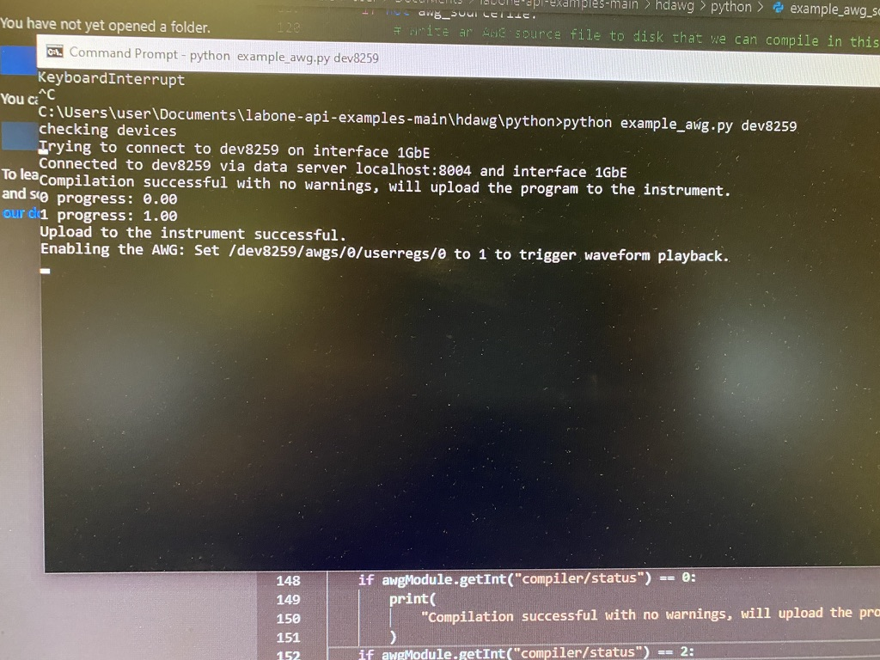
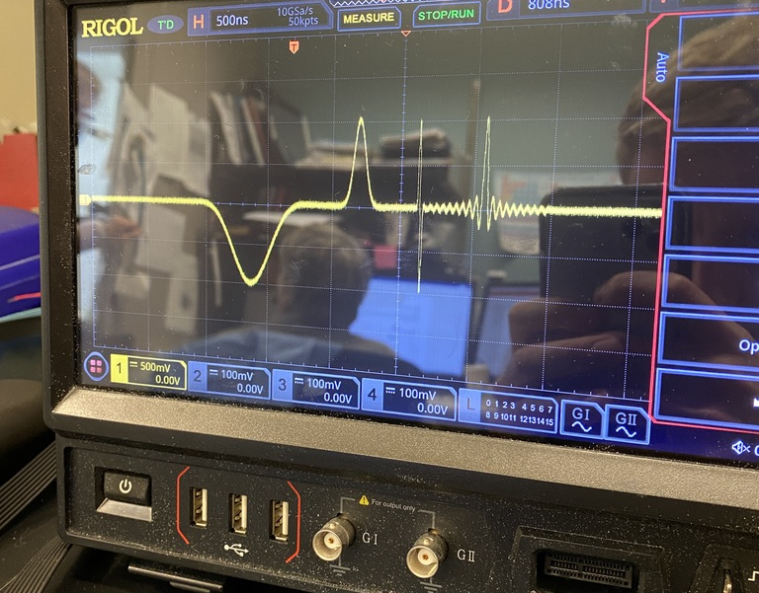
Successfully Connecting to Server from Python
example_awg.py
Read through code for understanding
Pip installed necessary libraries
Corrected node values to run
Placed wave output in a while(true) loop to run indefinitely

Slide 8
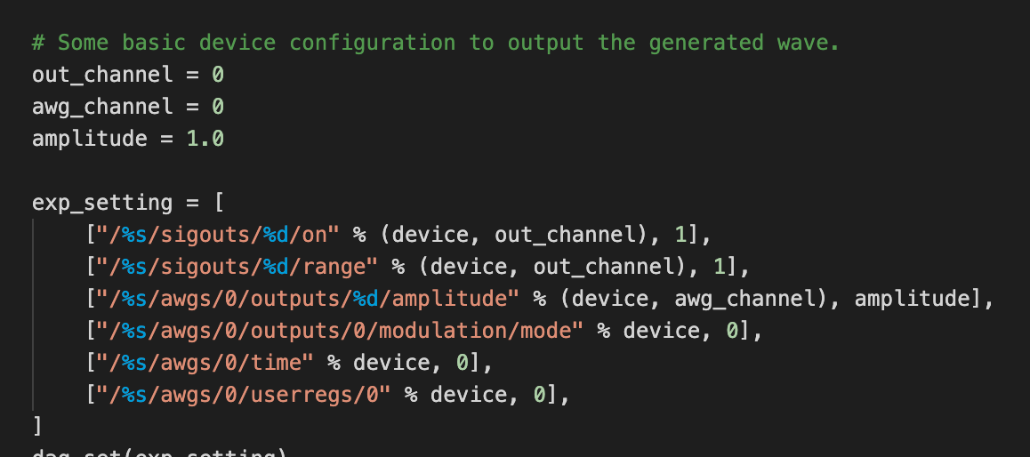
Important Example Code Blocks: AWG Settings

Slide 9
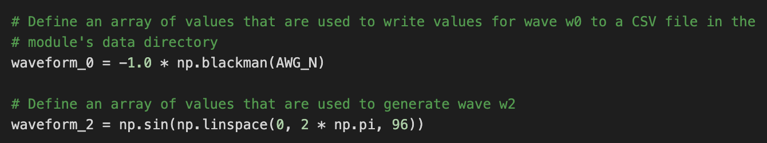
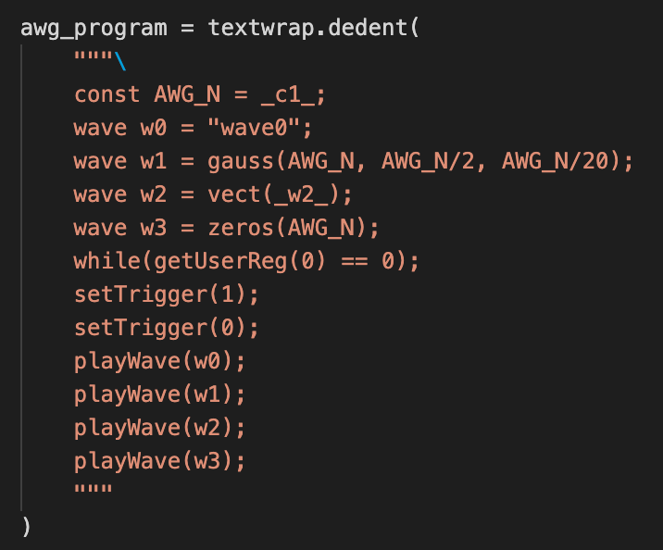
Important Example Code Blocks: Defining Waveforms

Slide 10
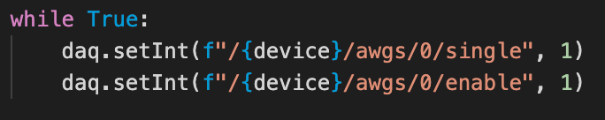
Important Example Code Blocks: Wave Generating Loop

Slide 11
Creating Python Script
ReadandCreateWave(1.2).py
Used example_awg.py as foundation
Imported csv and tkinter libraries
Used to load waveform .csv file
Formed arrays of values for desired waveforms (columns)
Generated temporary individual .csv files for each wave form
More efficient than setVector() function

Slide 12
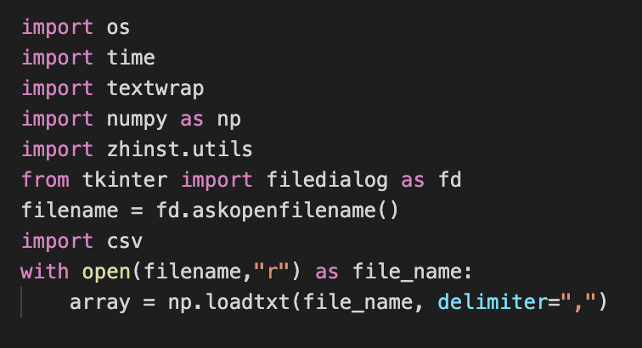
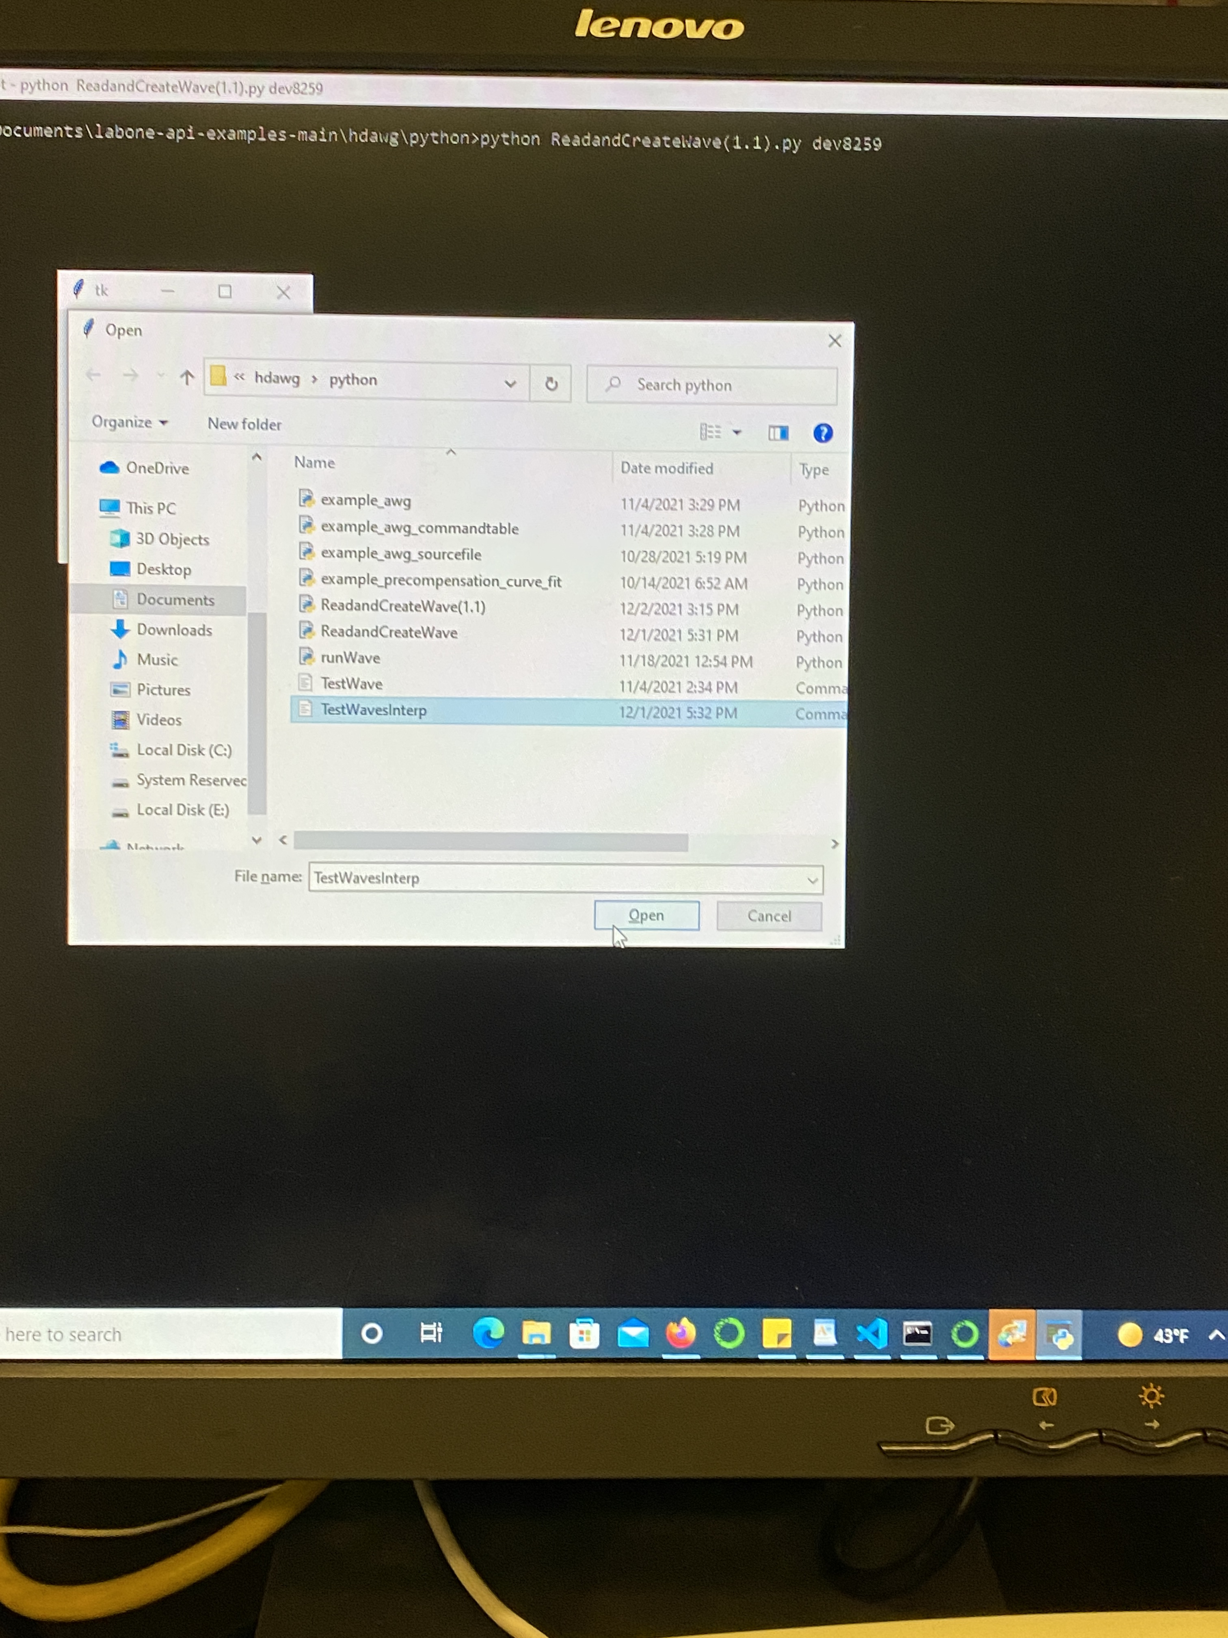
Important Code Blocks: Loading File

Slide 13
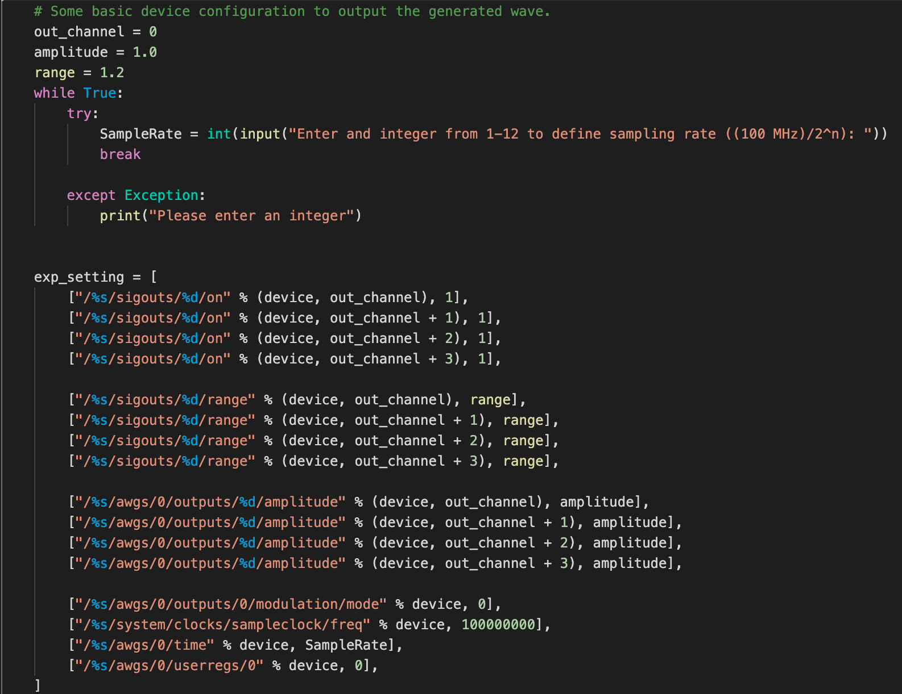
Important Code Blocks: Settings

Slide 14
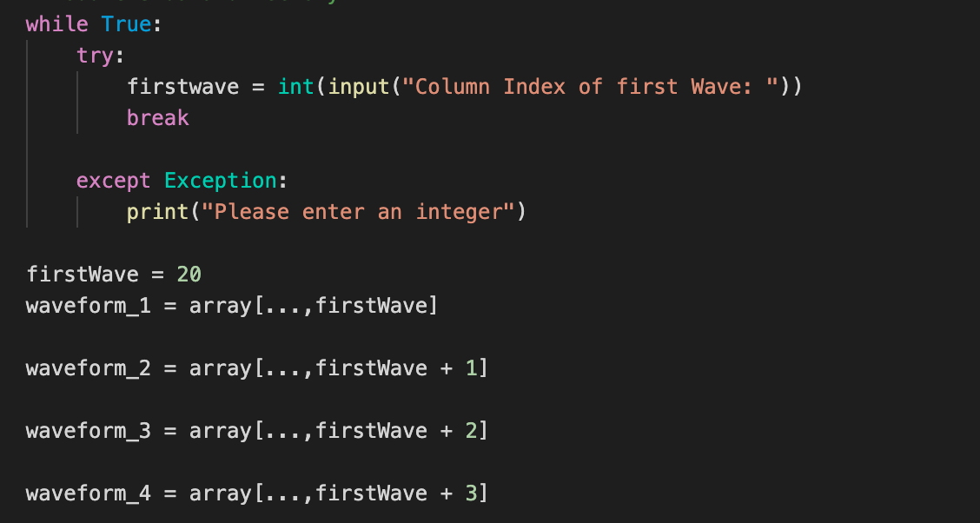
Important Code Blocks: Generating Waveforms

Slide 15
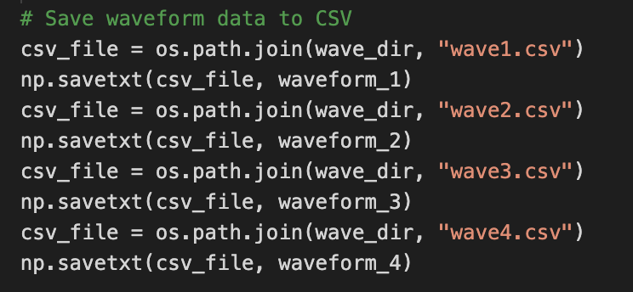
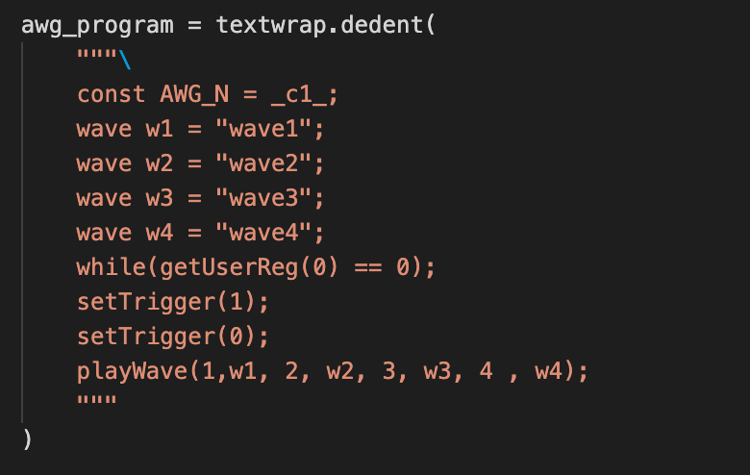
Important Code Blocks: Generating Waveforms

Slide 16
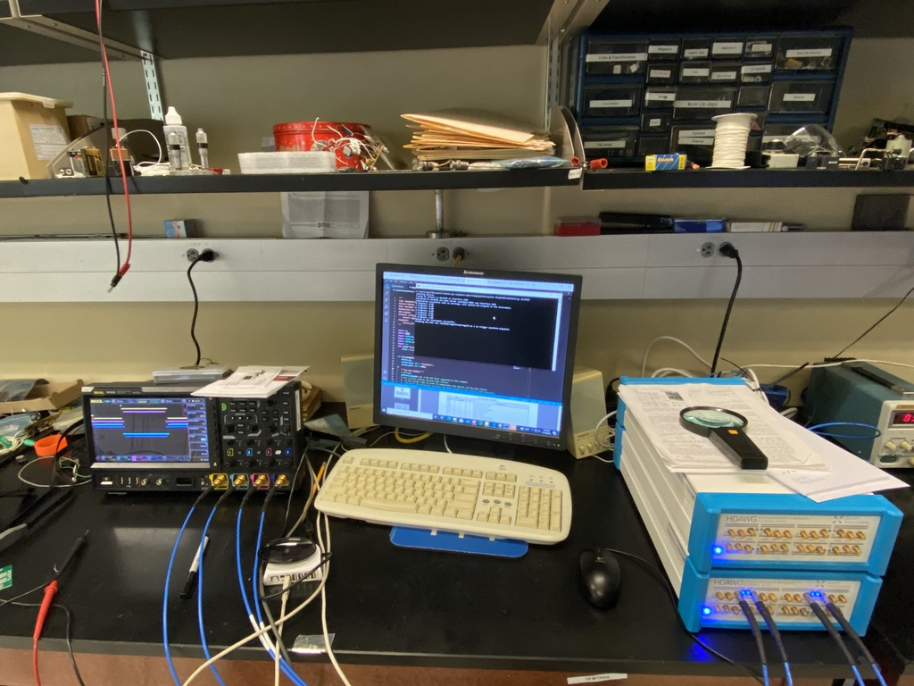
Results

Slide 17
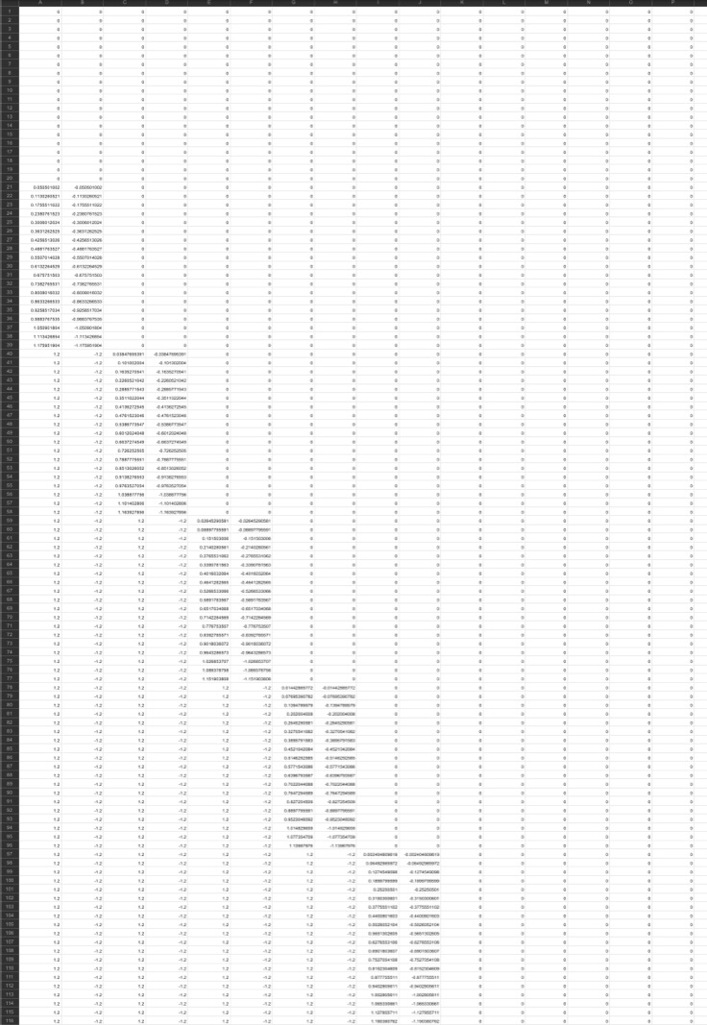
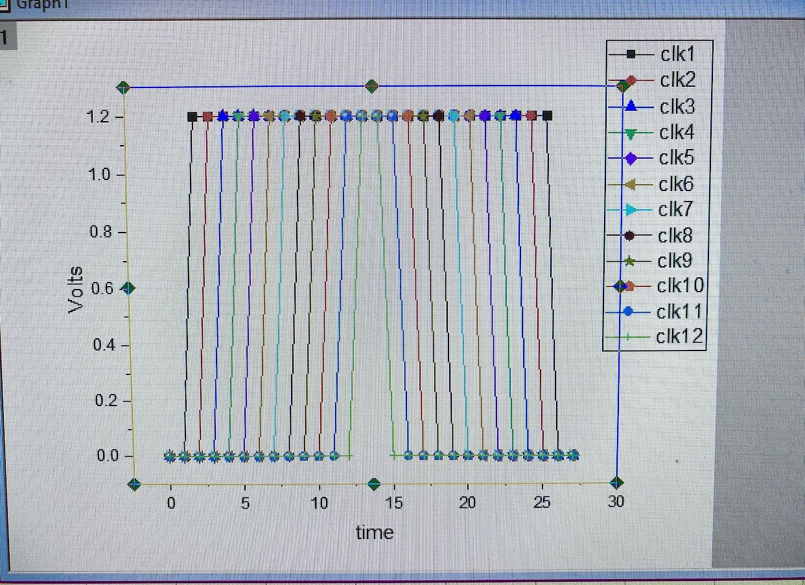
Obtaining Trapezoidal Waveforms
Interpolated waveforms from Rene in Origin
500 Points

Slide 18
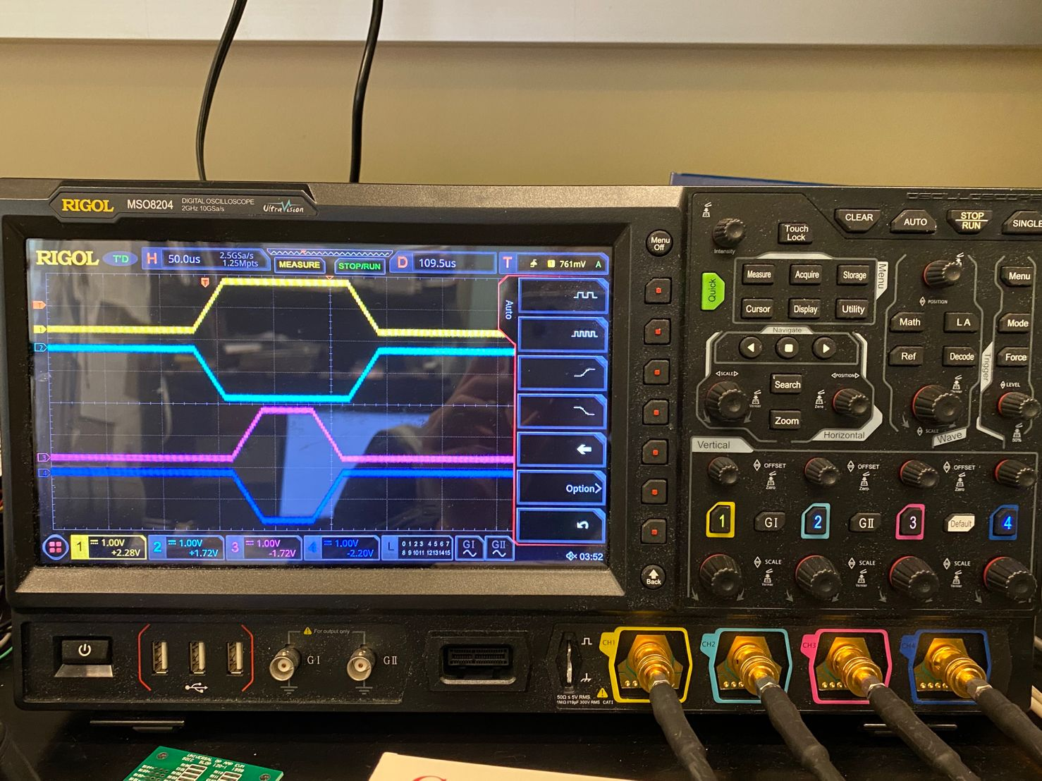
Generating interpolated waveforms

Slide 19

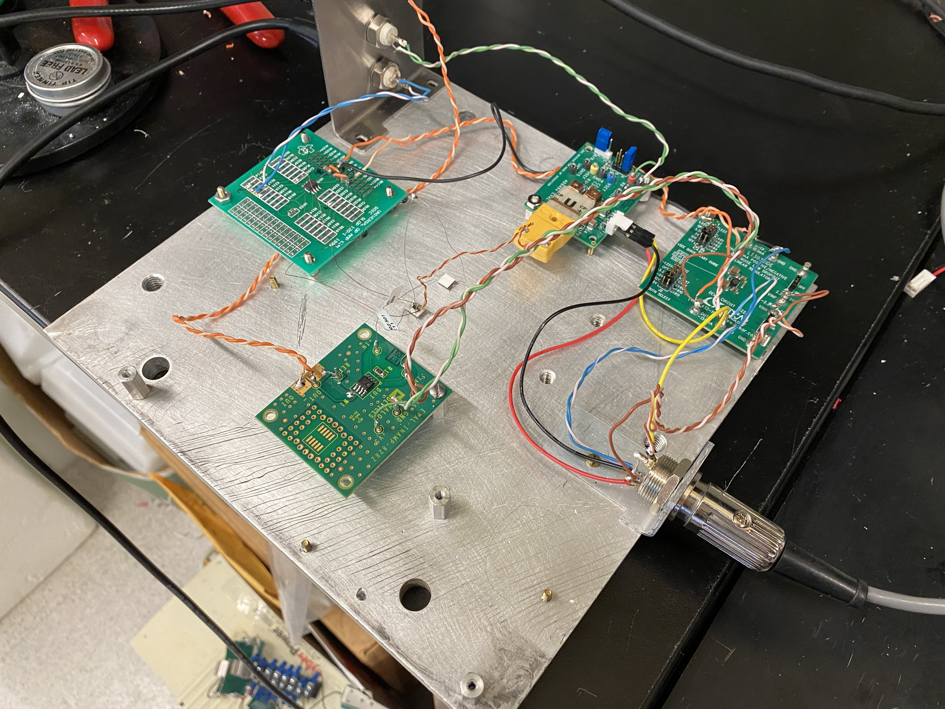
Project 2: Peltier Module Test Environment
Goal: Compare the sensitivity of Peltier Modules and Thermocouples when measuring temperature
Heat would come from a resistor connected to an operational amplifier as a current source

Slide 20
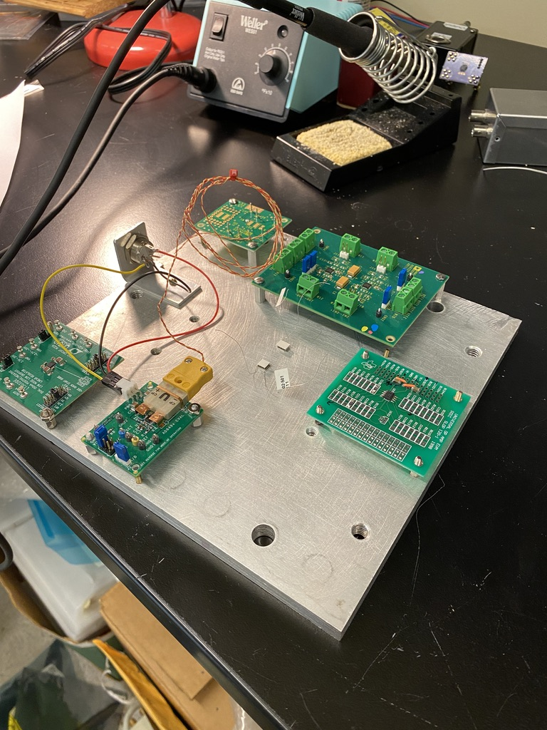
Setup
Arranged boards on aluminum plate
Marked holes to be drilled
Dr. Orlov drilled holes and placed the boards on stands

Slide 21
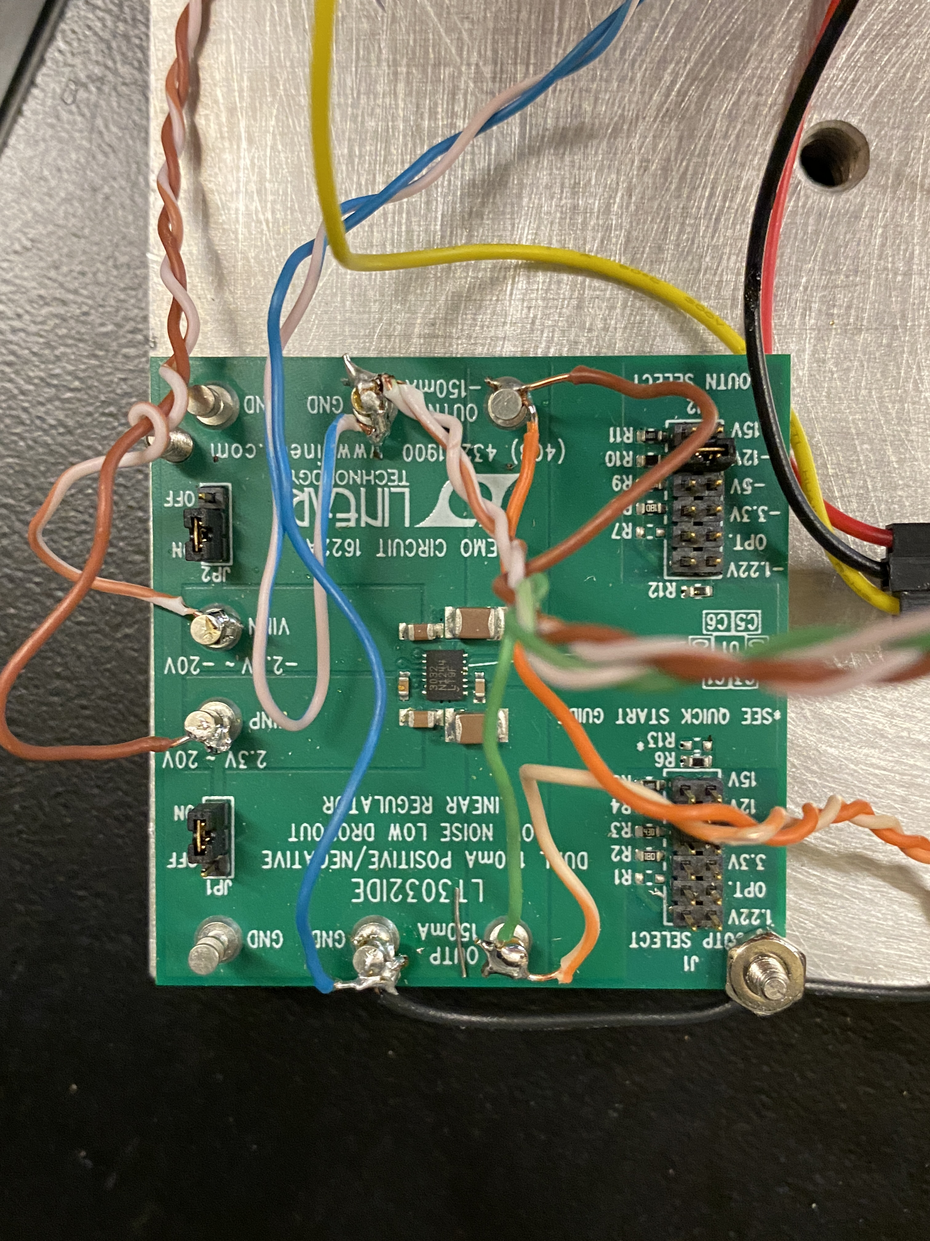
Power Supply
5 pin DIN plug
Soldered wires in parallel to thermocouple amplifier and voltage regulator

Slide 22
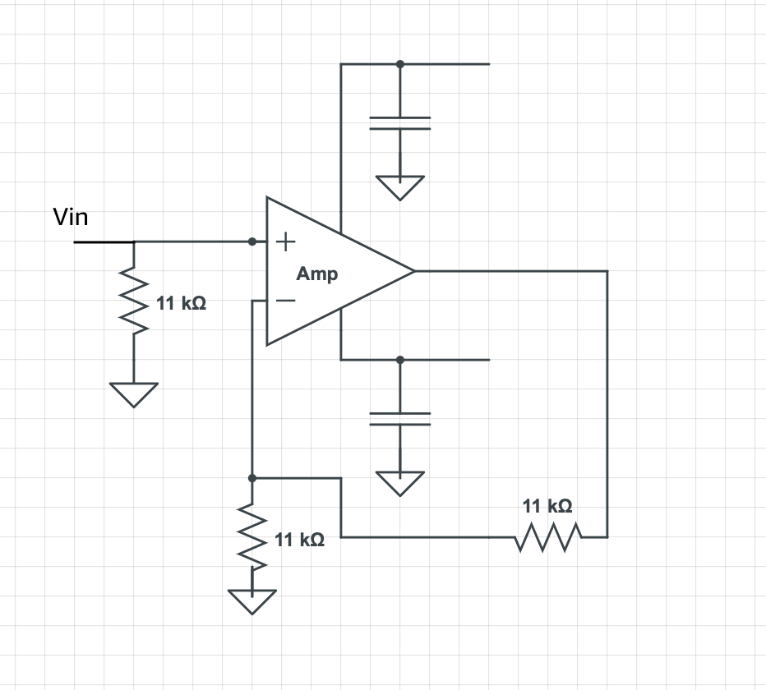
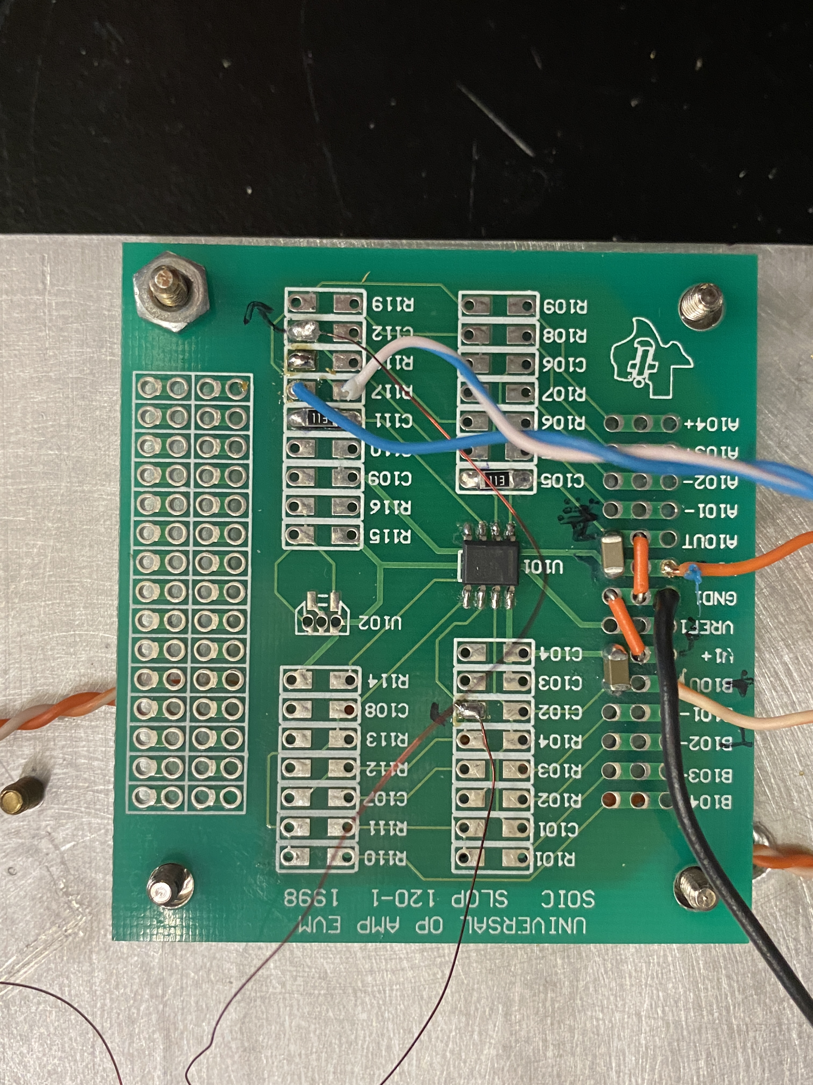
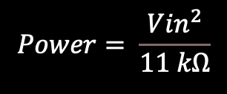
Assembling amplifier
$$Power= \frac{{Vin}^{2}}{11 kΩ}$$

Slide 23
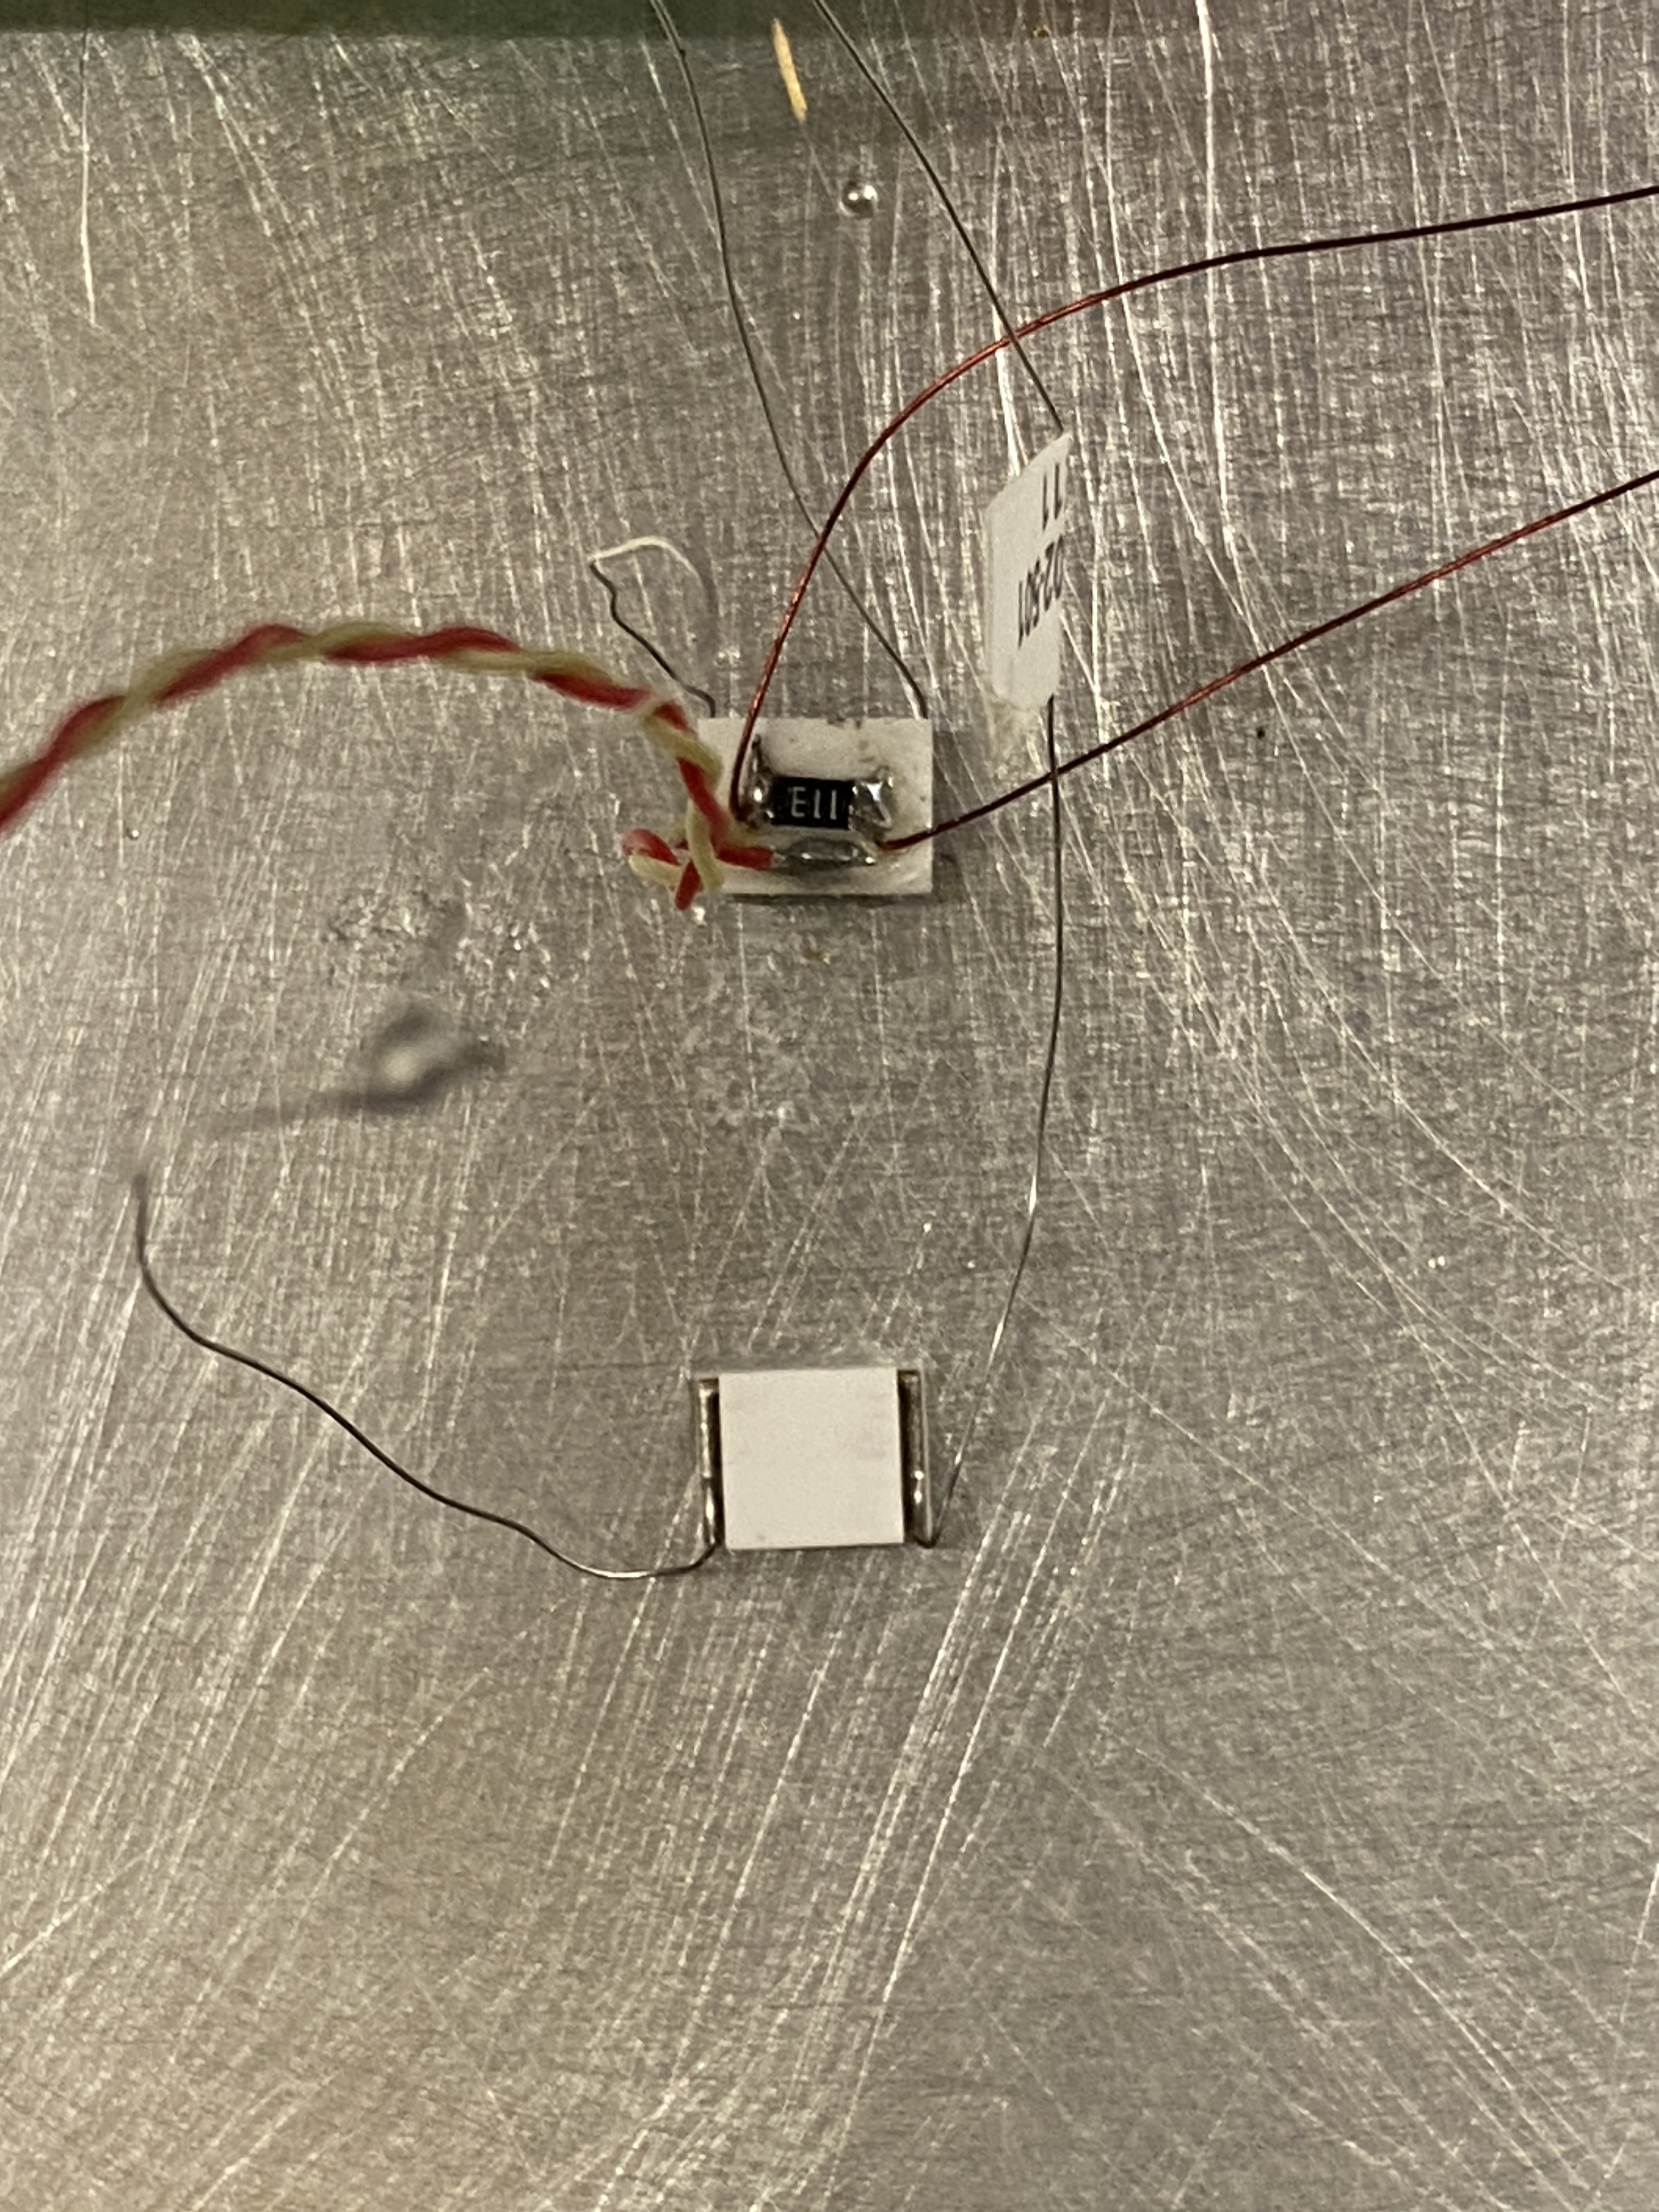
Peltier modules, Thermocouple, and resistor
Used Crazy glue to mount:
Peltier modules to aluminum plate
Resistor to top of Peltier Module
Thermocouple to top of Peltier Module
Crazy glue works well because it dries quickly and creates a very thin layer

Slide 24
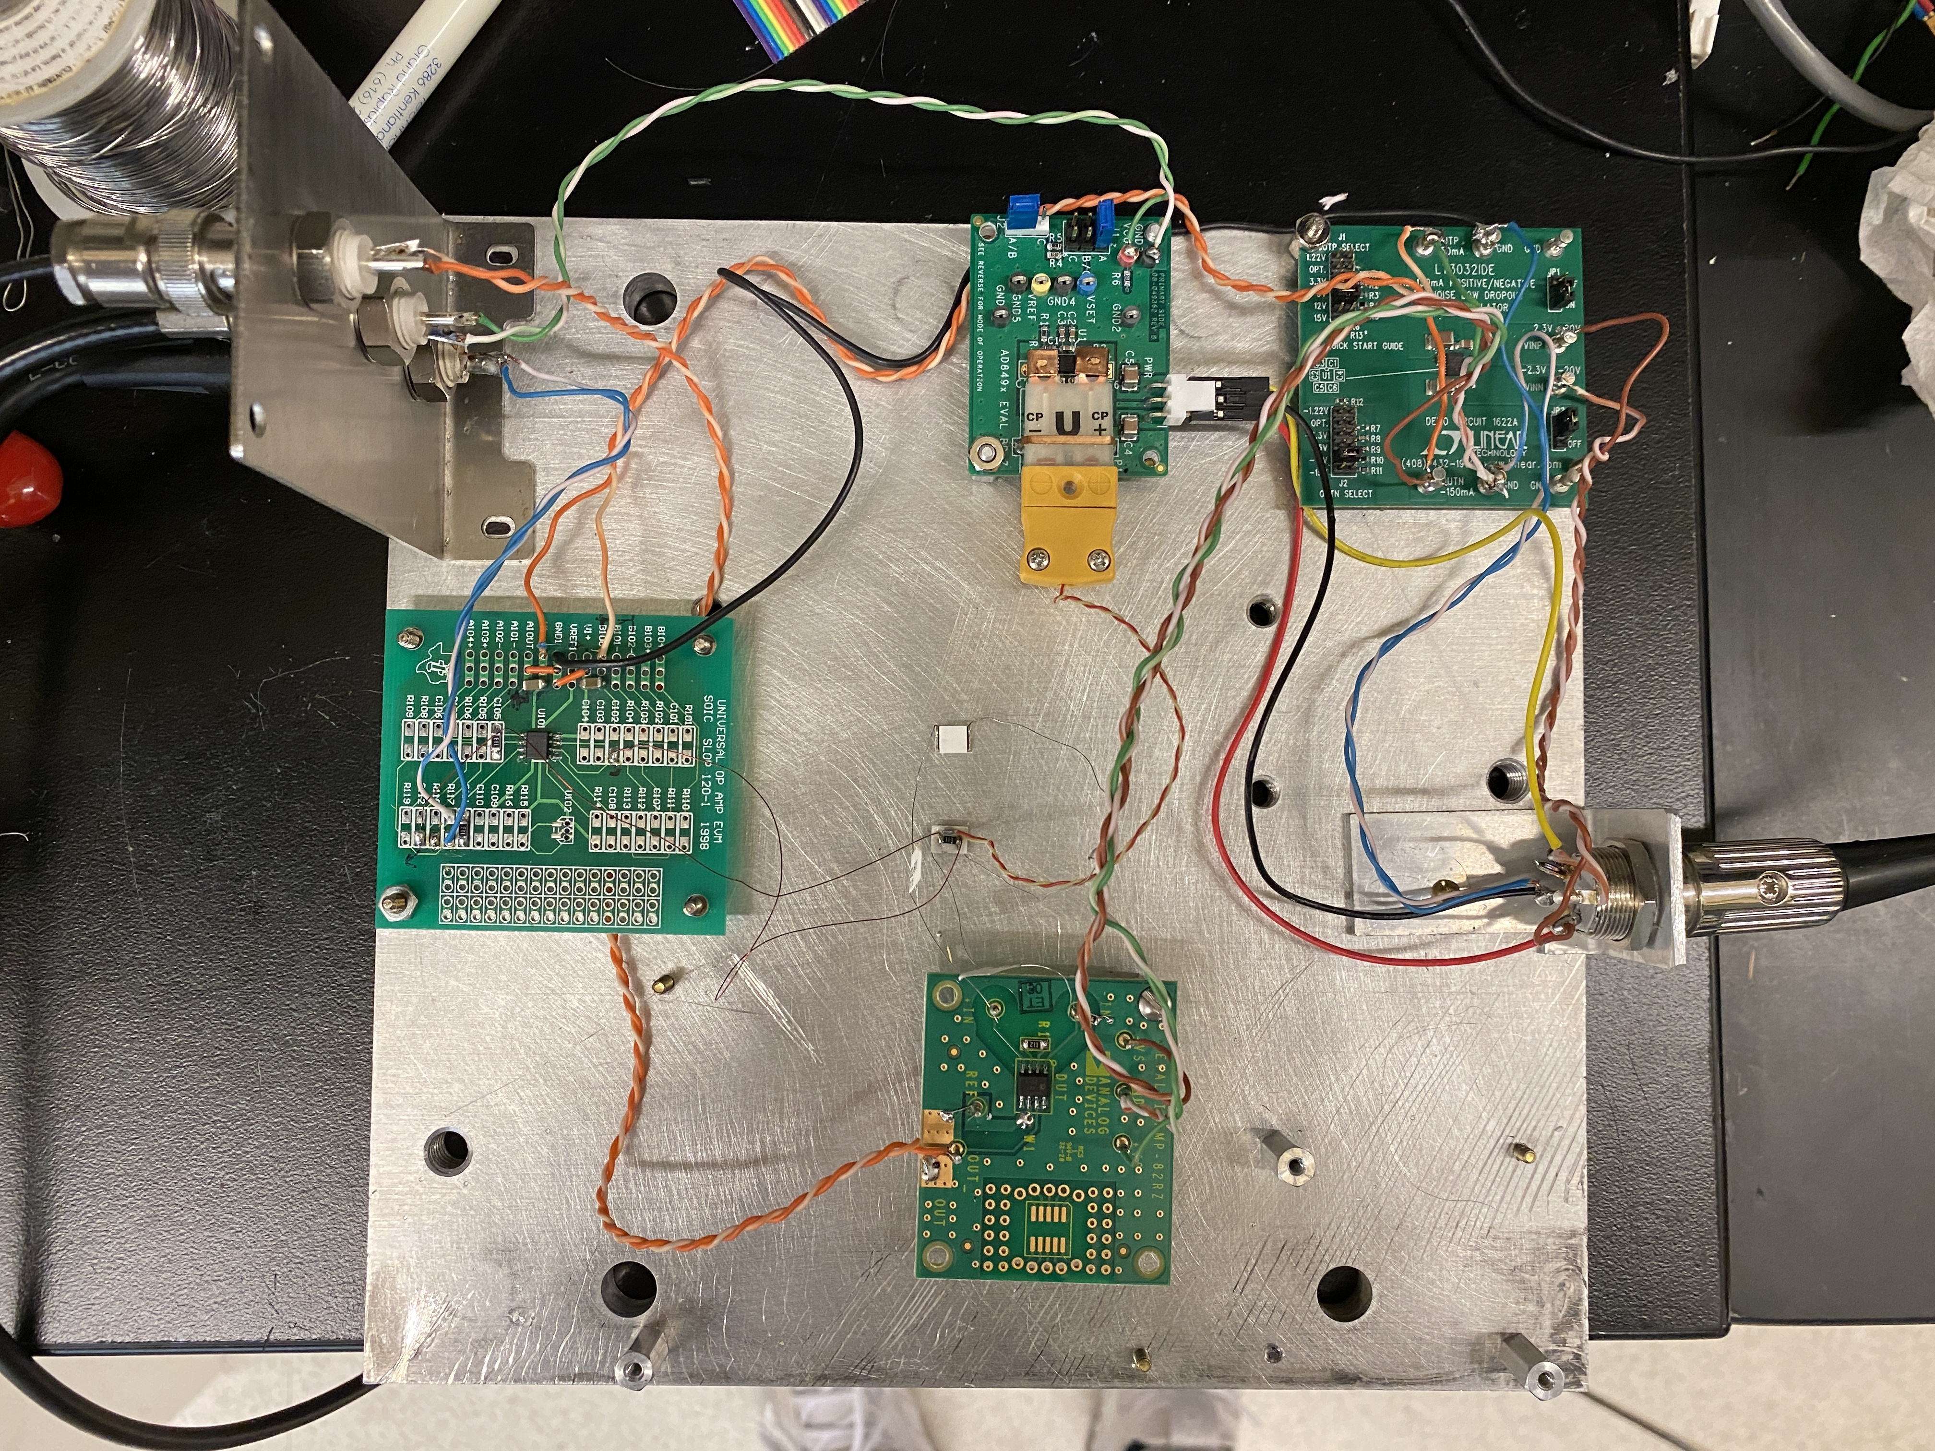
Results
Initial data showed the Peltier modules to be significantly more sensitive than the thermocouple
Peltier modules had longer settling time

Slide 25
Next Steps
Python Script
Implement an algorithm to automatically interpolate waveform data to account for desired frequency
Sampling rate of HDAWG: (BaseSampleClock)/2^{n}
n is an integer from 0 to 12
Sync AWGs to allow 16 output channels
Can refer to Jack Bannan’s attempt last semester
Peltier Module Test Environment
Conduct more testing using more accurate practices (e.g., Styrofoam cooler)

Slide 26
Thank You!

